Slide 1
World Peace Catalyst Fund (WPCF) – Ways to Make Money
"Help Bring Peace 1 Chat at a time”
“If there was 1 thing you could do for peace, would you do it?”
By Mudib Rawoot (President/Founder)

Slide 2
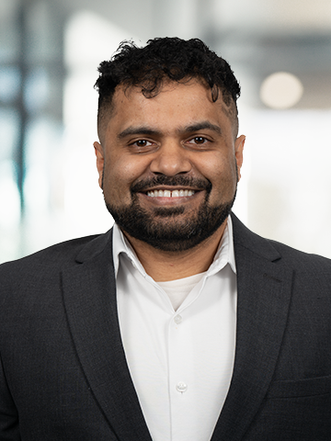





Mudib Rawoot
B.S. Chemical Engineering – Virginia Tech – 2010
M.S. Materials Engineering – University of Florida – 2012

Slide 3
World Peace Catalyst Fund
Registered and approved 501(c)(3) non-profit
Provides a safe, easy, effective way for you to help bring peace
Only world peace non-profit that provides an activity widely available

Slide 4

Unicorn
Icebreakers is a Unicorn
King of Unicorns actually
Has potential to bring in Billions each year, until the end of time
Food for thought – How many of the unicorns actually were unicorns?

Slide 5

Ways to make Money
25 ways
Mobile Application Market
  Advertisement revenue
  In app purchases (World Peace Store)
  Subscription level tiers
Art Space

Slide 6
Ways to make Money continued
Health Space
Love/Relationship Space
Government Grants/Contracts
  DOD, NSF, DOS, NEH, NIH, DOE, DHS, HHS, DOJ, NASA, NEA,

Slide 7
Ways to make money continued
Education space
  Training videos
  K-12
Spiritual Space
  Camps/Retreats/Training

Slide 8
Ways to Make Money Continued
Social Media Space
Peace Space
Donations (Non-Profit Space)

Slide 9
You Can make money also
There are ways for you to make money also
  From a few hundred to a thousands each year
Tax Credits
Your voice and heart matter on the march to peace

Slide 10
Market Size
Everyone with digital access (~6.7 billion users)
  ~ 3 billion android devices
  ~2.2 billion iPhone devices
  ~1.4 billion Windows users
  ~100 million Mac users
Total Addressable Market ~ 29 million/month

Slide 11
Market Size
28+ User Personas identified
Everyone needs peace
WPCF is only non-profit with an activity that can only bring us closer to peace
Who is going to say no?

Slide 12

Organizational Structure
Non-Profit
Will need to create a B-Corp when donations exceed the revenue generated
  At this point investor money will be needed
Non-Profit will own B-Corp

Slide 13
Why Non-Profit?
Donation + Grants = free money available
    Ex: $200k of free Google Ad Grant Money already spent
3.1M+ impressions since 2022, people associate WPCF symbol with peace
  This is what drove the new peace wave in recent years

Slide 14
Donation Vs Investment
WPCF will limit the ability to invest to only those who have donated
Those have donated, can invest an multiplier (unspecified at this time) of their donation
  Ex: $5,000 donation would allow donor to invest $50,000 with a 10x multiplier

Slide 15
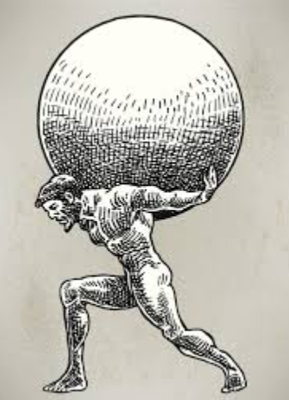
Why Donate?
Non-Profit provides safety
World Peace is very difficult to do, many pitfalls
No one has ever done this before, it will work, however it will take time
Non-Profit Space is under God’s Domain

Slide 16
Why Donate
‘Whatever you donate will be paid back to you in full, and you will not be wronged’ (2:272, Quran)
Not necessarily in $$$, however, spiritually they will benefit
World Peace is Complex
Many pitfalls and potential fail points

Slide 17
Why Donate?
  While WPCF works to overcome the pitfalls, the donation money ensures donors (potential investors) get something back
  At the time when it is needed to create a B-Corp, the chance of profitability for the investor is higher
  Win-Win

Slide 18
Why Donate?
We can either fail or we can succeed. The path we choose now determines our probability of each
Compare 2 options:
  Invest now => 60% Failure & 60% Success
  Donate now, invest later => 60% Failure & 40 % Success

Slide 19
Why Donate?
Investor will get benefits of donation & then will get a higher chance of profitability
Win-Win

Slide 20
The Ask - Donate
You should by now know the benefits of donating – karma, ajr, good vibes
Per Islam (Zakat) – you should donate 2.5% of your yearly salary
Per Christianity (tit) – you should donate 10% of your yearly salary
WPCF is asking for 0.5% - Can you help?

Slide 21
The ask – Raise $500k
$500k – Good for 6 months
At some point there will be a need to convert into a PBC – Do you want to invest?
$20 million – if I can raise this, I will never have to come back for money
Donate

Slide 22
Ask Breakdown – $500k
Salaries
  President, 1x developers, 1x tester, 1x artist, 1x analysts, 1x Advertiser, 1x social media rep
IT infrastructure
Insurance
Electronic Equipment
Detailed Justification available upon request

Slide 23
Feedback
Please provide feedback, comments, anything that will help. WPCF appreciates the support
Contact: Mudib Rawoot
Email: president@worldpeacecatalystfund.org
Please take our Survey

